Slide 1
E6156 – Topics in SW Engineering (F23) Cloud Computing Lecture 8: EDA Examples, API GW, JWT, Pagination
© Donald F. Ferguson, 2023

Slide 2

Some Aspects of My Solution/Project
2 | E6156 – Topics in SW Engineering: Cloud Computing: Lecture 8 - EDA Examples, API-GW, JWT, Pagination © Donald F. Ferguson, 2023

Slide 3
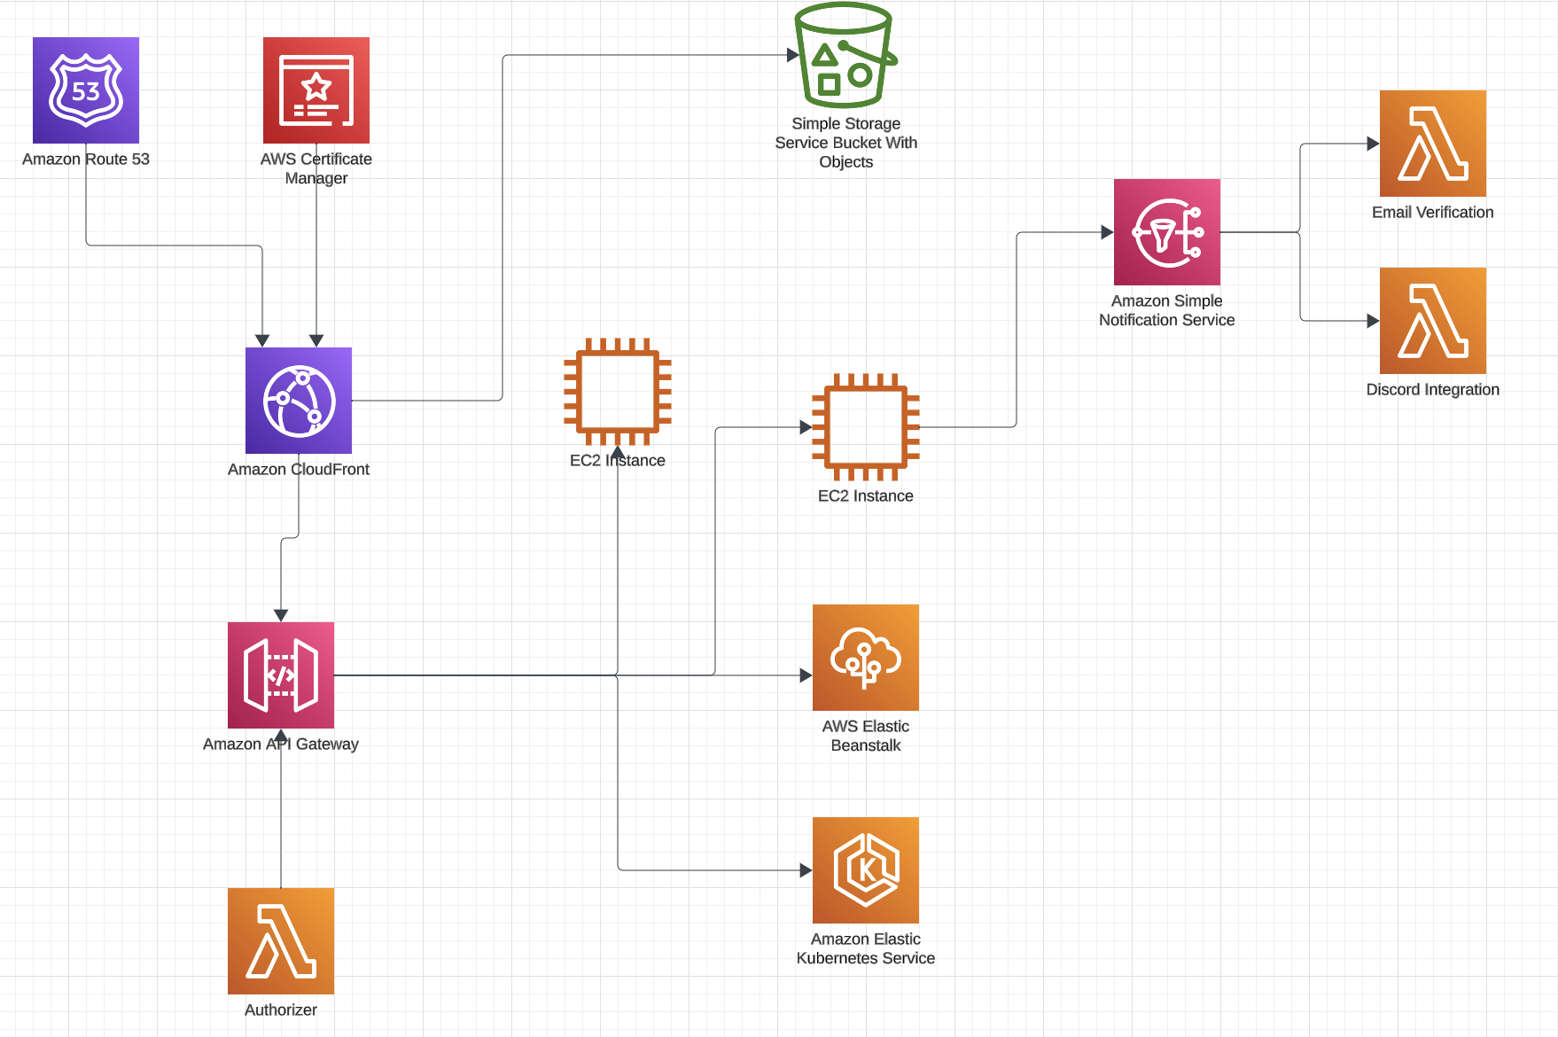
Partial Architecture Diagram
Brief overview of come concepts:
Route 53 and domain name servers
Certificate Manager and HTTPs
Cloud Front
API Gateway
Some details:
JSON Web Tokens
Lambda → Discord and Webhooks
Composite services
Security, Lambda Authorizer

Slide 4
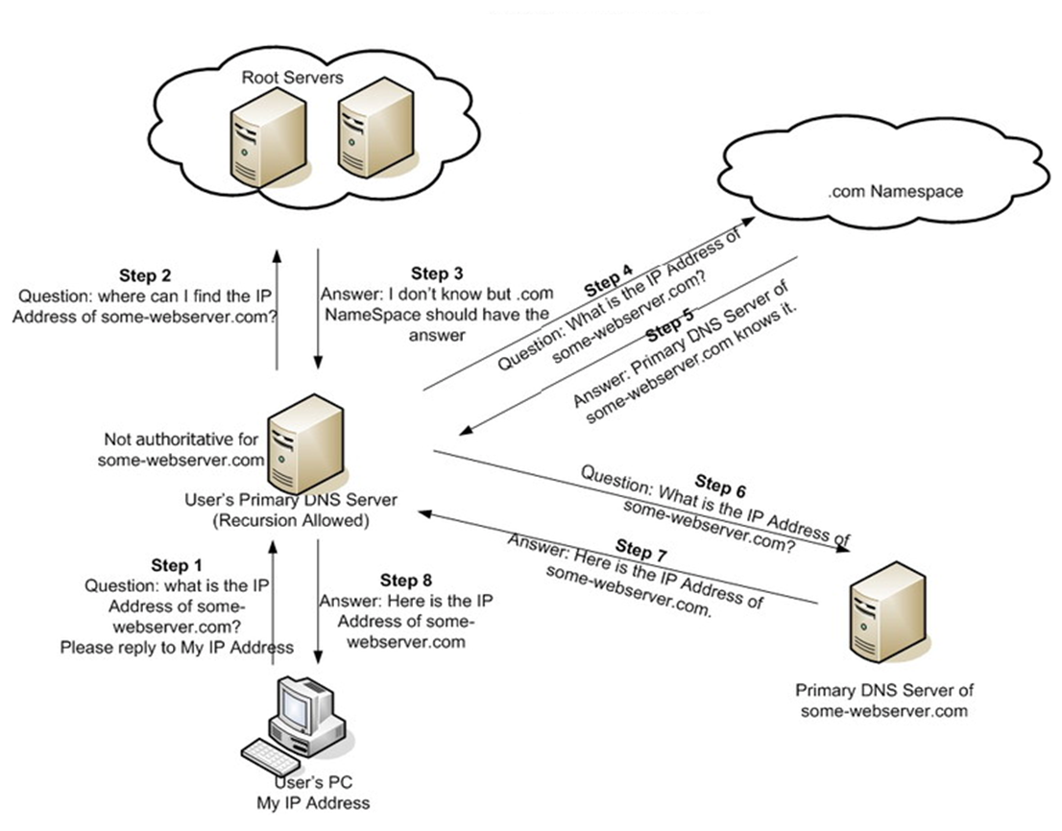
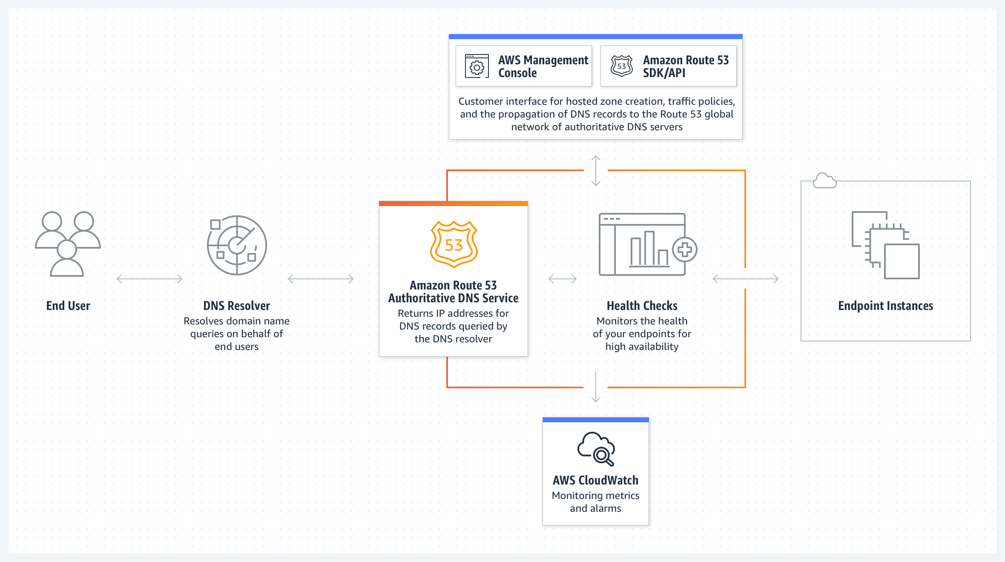
DNS and Route 53
Internet connectivity relies on IP addresses.
V4: 164.86.3.127
V6: 2001:db8:3333:4444:CCCC:DDDD:EEEE:FFFF
DNS transforms “names” like www.columbia.edu to IP addresses
May implement more advanced functions like load balancing, … …
Most large environments have a private IP address space, with some of the nodes also having a public IP address.
This is due to the limitations on the number of IP addresses publicly available.
There are network address translation gateways at the perimeter.

Slide 5
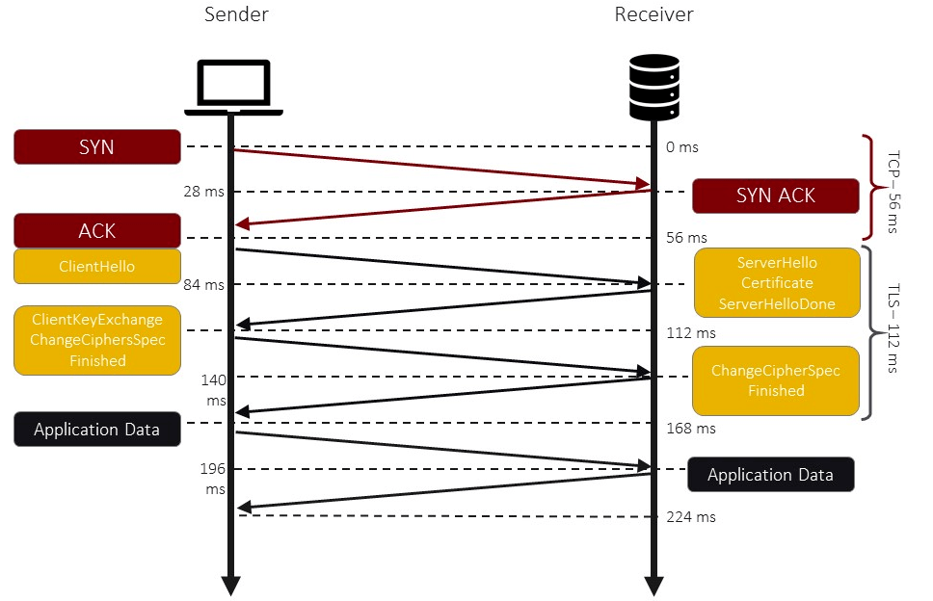
HTTPS
Hypertext Transfer Protocol Secure (HTTPS) is an extension of the Hypertext Transfer Protocol (HTTP). It uses encryption for secure communication over a computer network, and is widely used on the InternetIn HTTPS, the communication protocol is encrypted using Transport Layer Security (TLS) or, formerly, Secure Sockets Layer (SSL). The protocol is therefore also referred to as HTTP over TLS,[3] or HTTP over SSL.
… …
The principal motivations for HTTPS are authentication of the accessed website and protection of the privacy and integrity of the exchanged data while it is in transit. It protects against man-in-the-middle attacks, …
The authentication aspect of HTTPS requires a trusted third party to sign server-side digital certificates.
https://anushadasari.medium.com/the-https-protocol-explained-under-the-hood-c7bd9f9aaa7b
https://en.wikipedia.org/wiki/HTTPS

Slide 6
Certificates
Web browsers know how to trust HTTPS websites based on certificate authorities that come pre-installed in their software. Certificate authorities are in this way being trusted by web browser creators to provide valid certificates. Therefore, a user should trust an HTTPS connection to a website if and only if all of the following are true:
The user trusts that their device, hosting the browser and the method to get the browser itself, is not compromised (i.e. there is no supply chain attack).
The user trusts that the browser software correctly implements HTTPS with correctly pre-installed certificate authorities.
The user trusts the certificate authority to vouch only for legitimate websites (i.e. the certificate authority is not compromised and there is no mis-issuance of certificates).
The website provides a valid certificate, which means it was signed by a trusted authority.
The certificate correctly identifies the website (e.g., when the browser visits "https://example.com", the received certificate is properly for "example.com" and not some other entity).
The user trusts that the protocol's encryption layer (SSL/TLS) is sufficiently secure against eavesdroppers

Slide 7
Certificates and PKI
A public key infrastructure (PKI) is a set of roles, policies, hardware, software and procedures needed to create, manage, distribute, use, store and revoke digital certificates and manage public-key encryption.
… …
In cryptography, a PKI is an arrangement that binds public keys with respective identities of entities (like people and organizations).[1] The binding is established through a process of registration and issuance of certificates at and by a certificate authority (CA)
PKI provides "trust services" - in plain terms trusting the actions or outputs of entities, be they people or computers. Trust service objectives respect one or more of the following capabilities: Confidentiality, Integrity and Authenticity (CIA).
Confidentiality: Assurance that no entity can maliciously or unwittingly view a payload in clear text. Data is encrypted to make it secret, such that even if it was read, it appears as gibberish. Perhaps the most common use of PKI for confidentiality purposes is in the context of Transport Layer Security (TLS). TLS is a capability underpinning the security of data in transit, i.e. during transmission. A classic example of TLS for confidentiality is when using an internet browser to log on to a service hosted on an internet based web site by entering a password.
Integrity: Assurance that if an entity changed (tampered) with transmitted data in the slightest way, it would be obvious it happened as its integrity would have been compromised. Often it is not of utmost importance to prevent the integrity being compromised (tamper proof), however, it is of utmost importance that if integrity is compromised there is clear evidence of it having done so (tamper evident).
Authenticity: Assurance that every entity has certainty of what it is connecting to, or can evidence its legitimacy when connecting to a protected service. The former is termed server-side authentication - typically used when authenticating to a web server using a password. The latter is termed client-side authentication - sometimes used when authenticating using a smart card (hosting a digital certificate and private key).

Slide 8
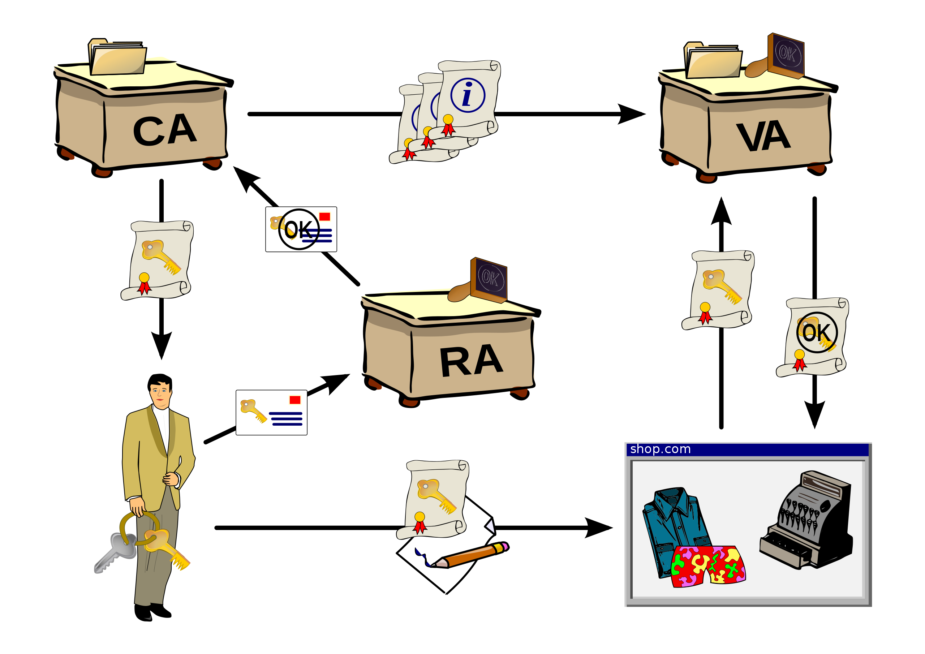
PKI
A PKI consists of:
A certificate authority (CA) that stores, issues and signs the digital certificates;
A registration authority (RA) which verifies the identity of entities requesting their digital certificates to be stored at the CA;
A central directory—i.e., a secure location in which keys are stored and indexed;
A certificate management system managing things like the access to stored certificates or the delivery of the certificates to be issued;
A certificate policy stating the PKI's requirements concerning its procedures. Its purpose is to allow outsiders to analyze the PKI's trustworthiness.
In my environment:
AWS Certificate Authority is the CA
Route 53 is the Registration Authority
Embedded technology in browsers verifies server side certificates.
To show:
Certificate in browser.
Route 53
Certificate Manager
Certificate in CloudFront

Slide 9
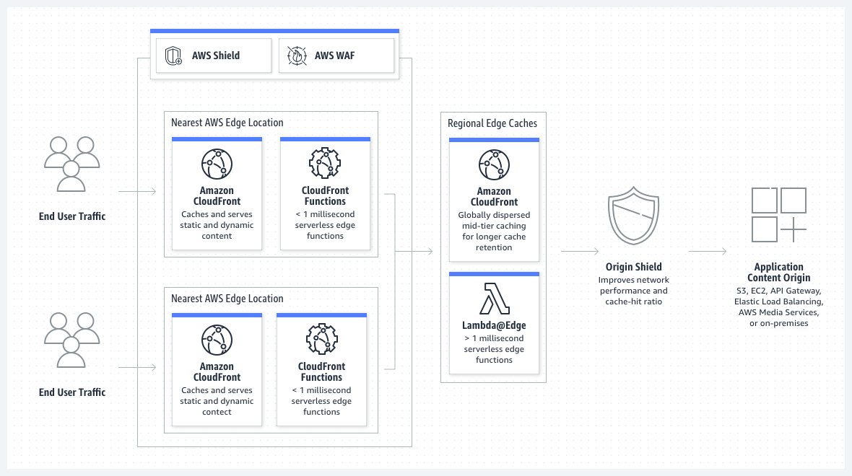
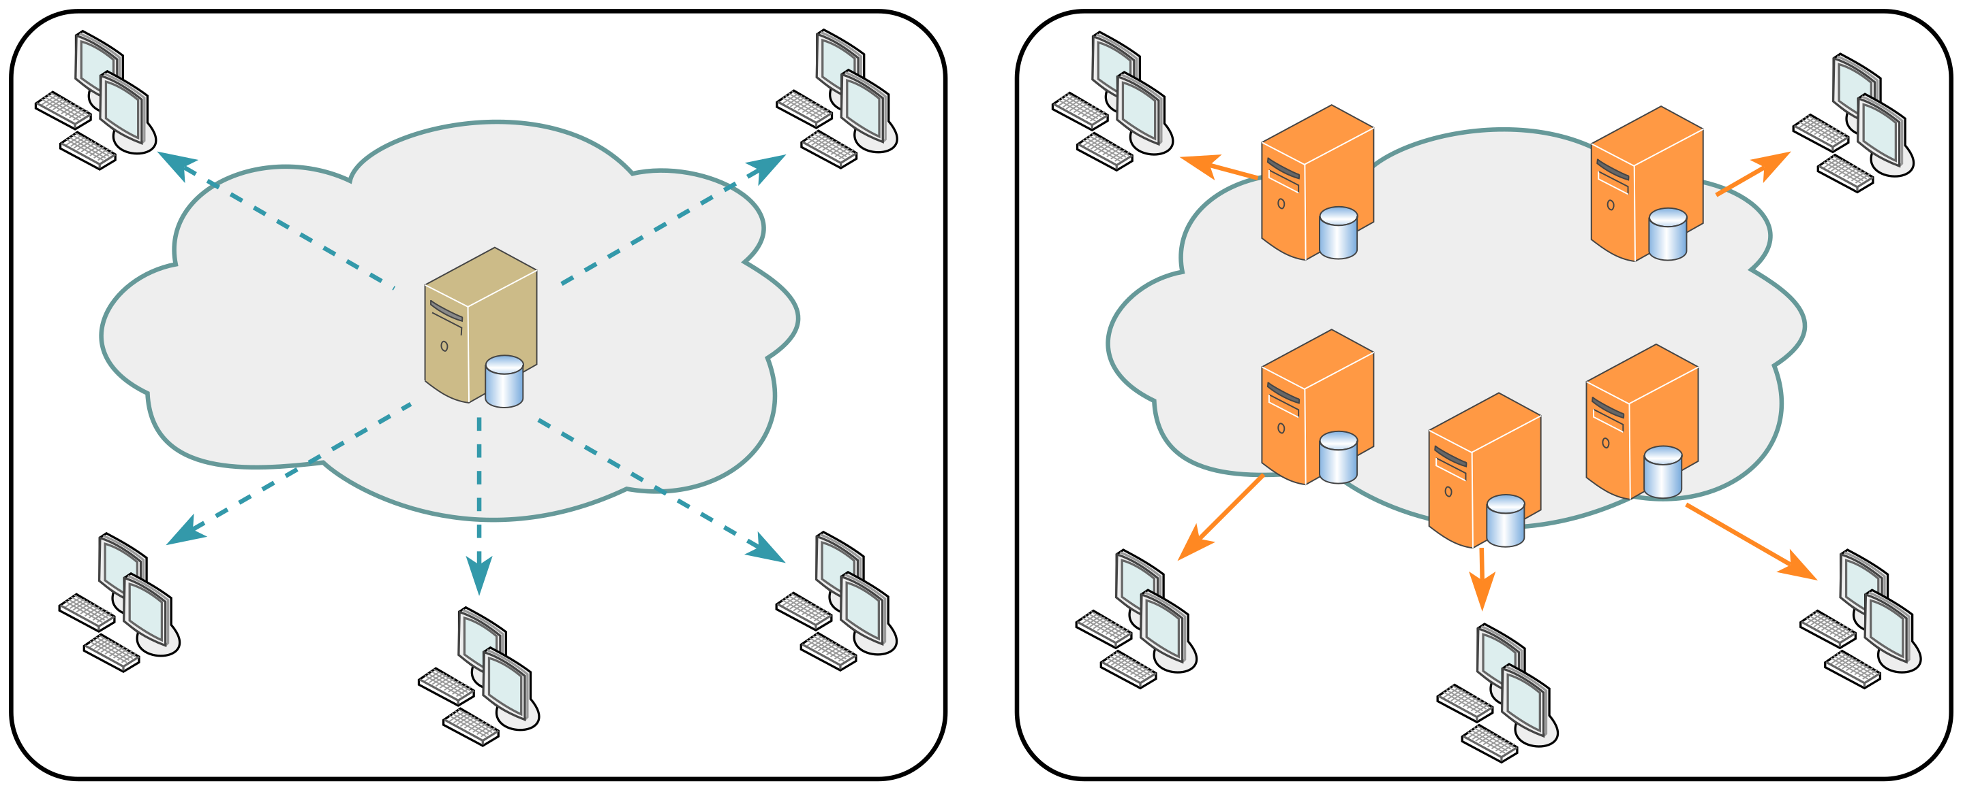
Cloud Front
Single Server
CDN
“A content delivery network, or content distribution network (CDN), is a geographically distributed network of proxy servers and their data centers. The goal is to provide high availability and performance by distributing the service spatially relative to end users.” https://en.wikipedia.org/wiki/Content_delivery_network
They key concepts are: Origin Server, Edge Server, Cache Policy
To show: CloudFront, HTTP cache headers.

Slide 10
Composition, Orchestration, Choreography Event Driven Architecture Examples
10 | E6156 – Topics in SW Engineering: Cloud Computing: Lecture 8 - EDA Examples, API-GW, JWT, Pagination © Donald F. Ferguson, 2023

Slide 11
Some Concepts
There are two concepts but without precise, universally agreed meanings.
Orchestration: “On the other hand, the orchestrator sends a command message to downstream microservices, telling it what operation to perform. After this microservice has performed the operation, it sends a reply message to the orchestrator. The orchestrator then processes the message and determines which next step to perform.”
Choreography: ”With choreography, you inform each part of the system of its job and let it work out the details, like dancers all finding their way and reacting to others around them in a ballet.”
There are many good overviews of the concepts”
https://ninetailed.io/blog/microservices-orchestration/
https://camunda.com/blog/2023/02/orchestration-vs-choreography/
https://docs.aws.amazon.com/prescriptive-guidance/latest/cloud-design-patterns/orchestration-choreography.html
https://betterprogramming.pub/microservice-orchestration-vs-choreography-5595b602fe3b

Slide 12
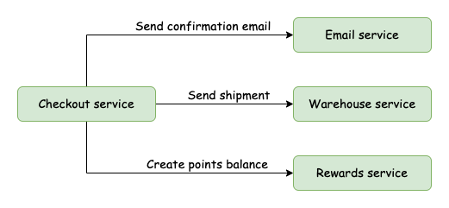
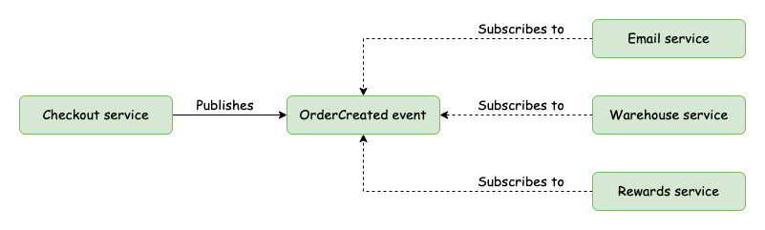
Orchestration and Choreography
Orchestration
Orchestration:
A N+1 service implements the composition logic.
Sends messages/events to other services to coordinate actions.
Choreography:
Each service is independent and knows its function.
Subscribes to and published events.
Choreography

Slide 13
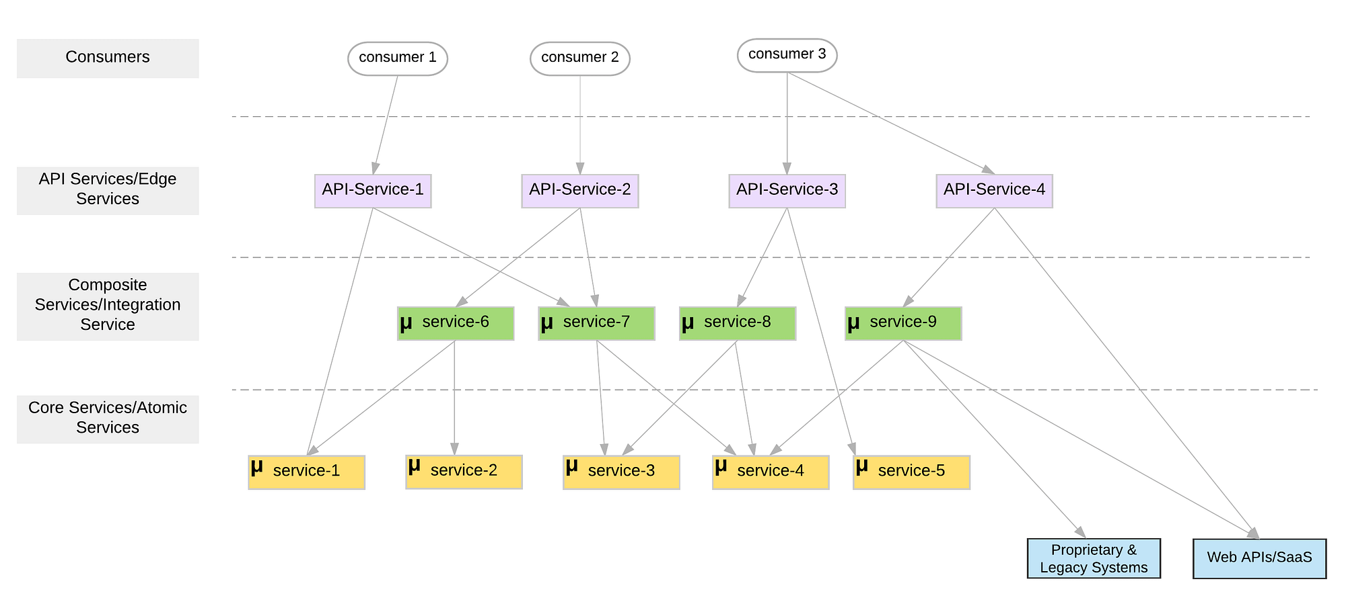
Microservice Layers

Slide 14
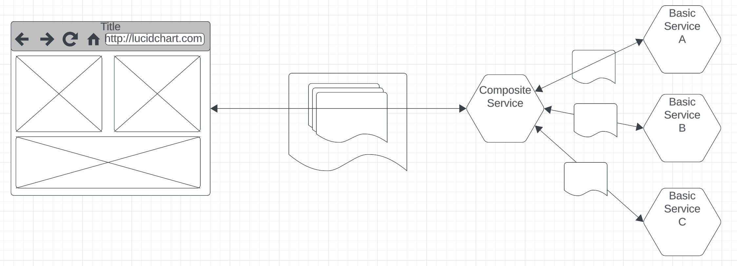
Composite Service
Users and applications think in terms of composite domain objects, e.g. a student is composed of: basic information, course registrations, projects, … …
UIs and other clients want to “retrieve the whole thing” and “update the whole thing.”
Implementing composition in the browser is a poor design.
In general, a lot of business logic in the browser/client is a poor idea. Prone to errors and fragile when things change.
Something has to handle the operations on the composite
Constraints between the objects.
Read or update failures of parts of the composite
Etc.
So, our next task is fleshing out implementation of the basic services functions and simple composite.

Slide 15
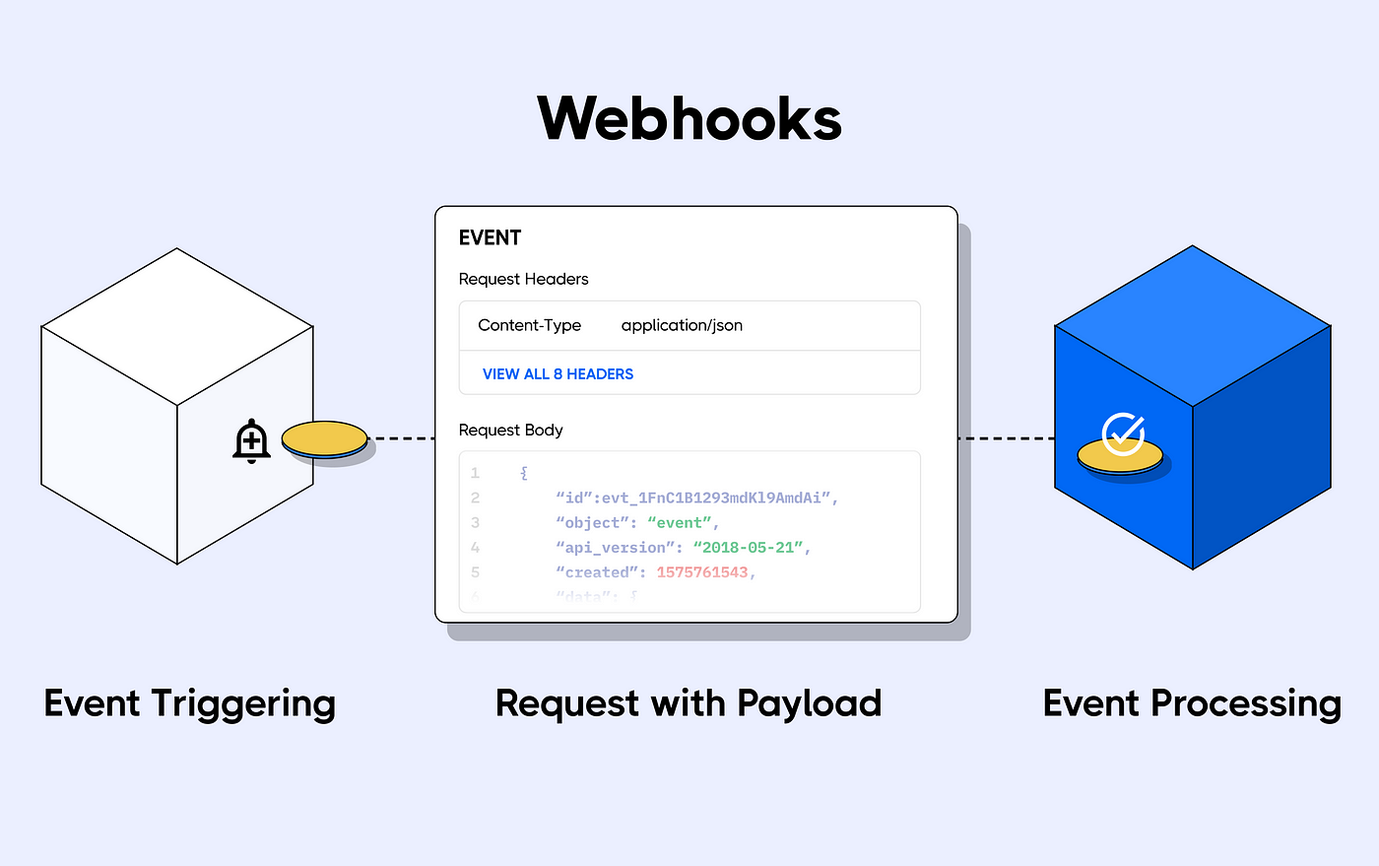
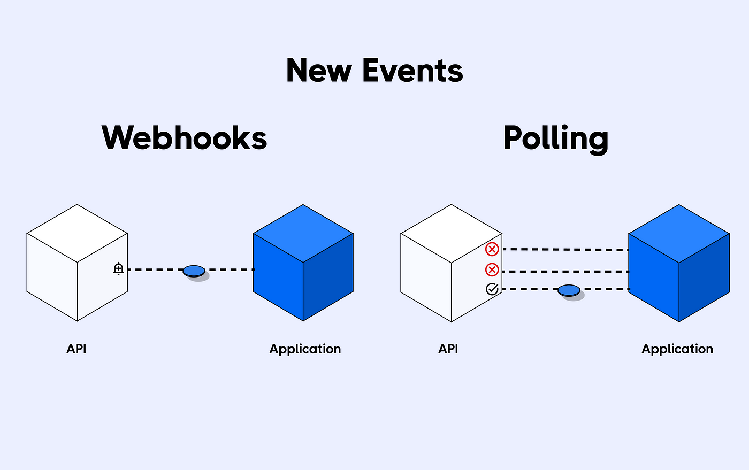
Webhooks
https://medium.com/hookdeck/webhooks-explained-what-are-webhooks-and-how-do-they-work-90c613c055a4
Webhooks are a form of subscription.
Used to connect web/REST applications using HTTP.
Often used to integrate with user collaboration and user automation systems (Slack, Discord, …) with applications.

Slide 16
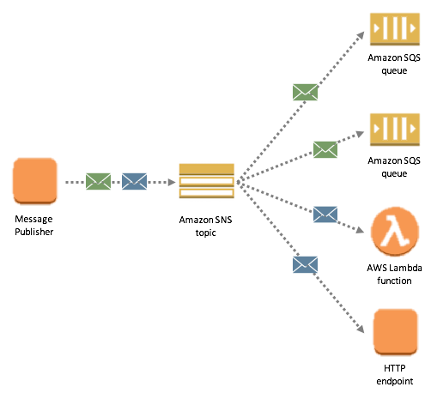
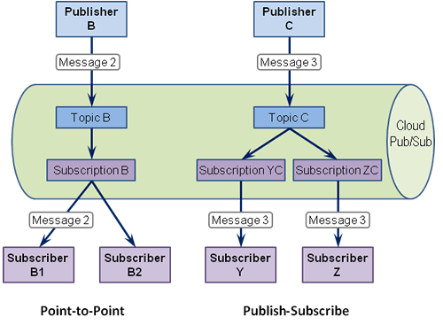
Pub/Sub
Reshow the topic, subscription, API keys, publication, webhook for the Discord example.

Slide 17
API Gateway JWT Authorization
17 | E6156 – Topics in SW Engineering: Cloud Computing: Lecture 8 - EDA Examples, API-GW, JWT, Pagination © Donald F. Ferguson, 2023

Slide 18
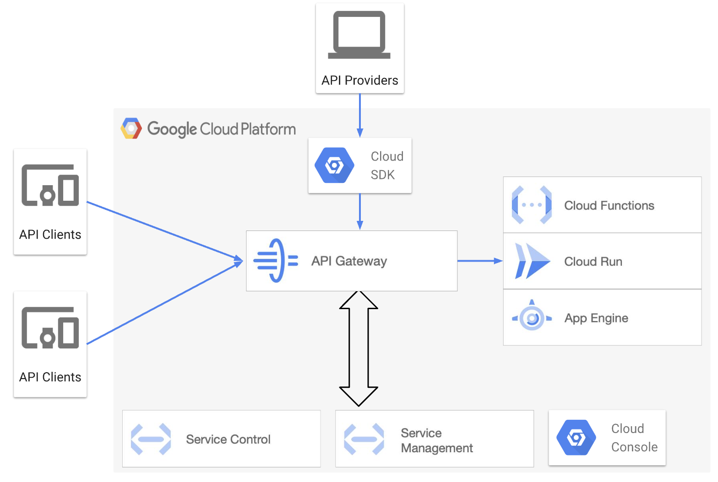
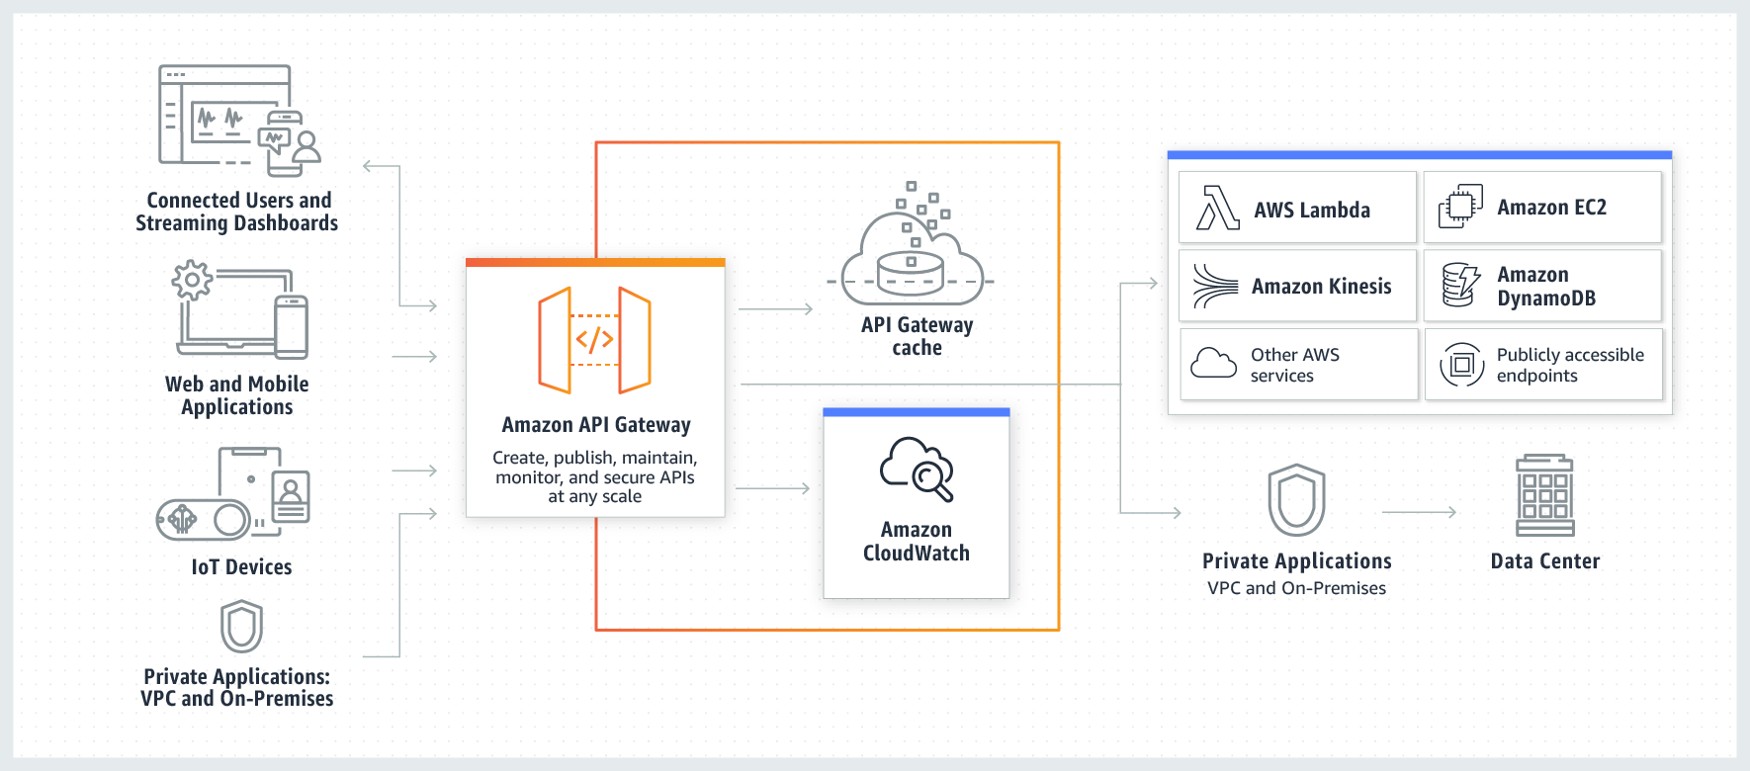
API Gateway
API Management and API Gateways are fundamental concepts.
Vastly simplifies changing microservice architectures, monitoring, enforcing security, throttling, versioning, … …
We will do some simple stuff with a gateway, starting with security.

Slide 19
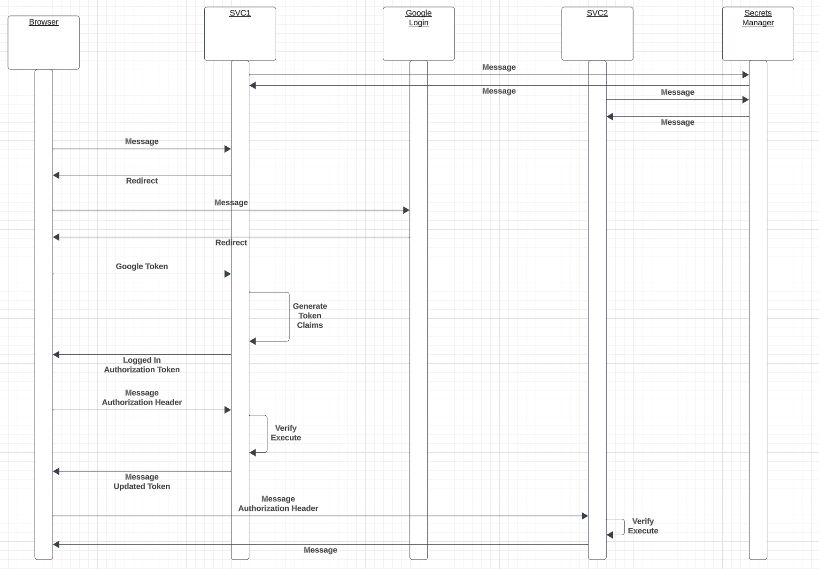
Login and Authorization Tokens
We have seen Google Login.
Forms the basics of authentication.
The server applications:
”Look up” user info in their database and systems.
Determine what operations the user can perform.
Generate a JWT Authorization containing signed claims.
Returns the token in an authorization header.
The client
“Saves” the token.
Attached to subsequent calls.
Servers can then authorize based on
Verifying the signature.
Checking that the client has a claim authorizing the operation.

Slide 20
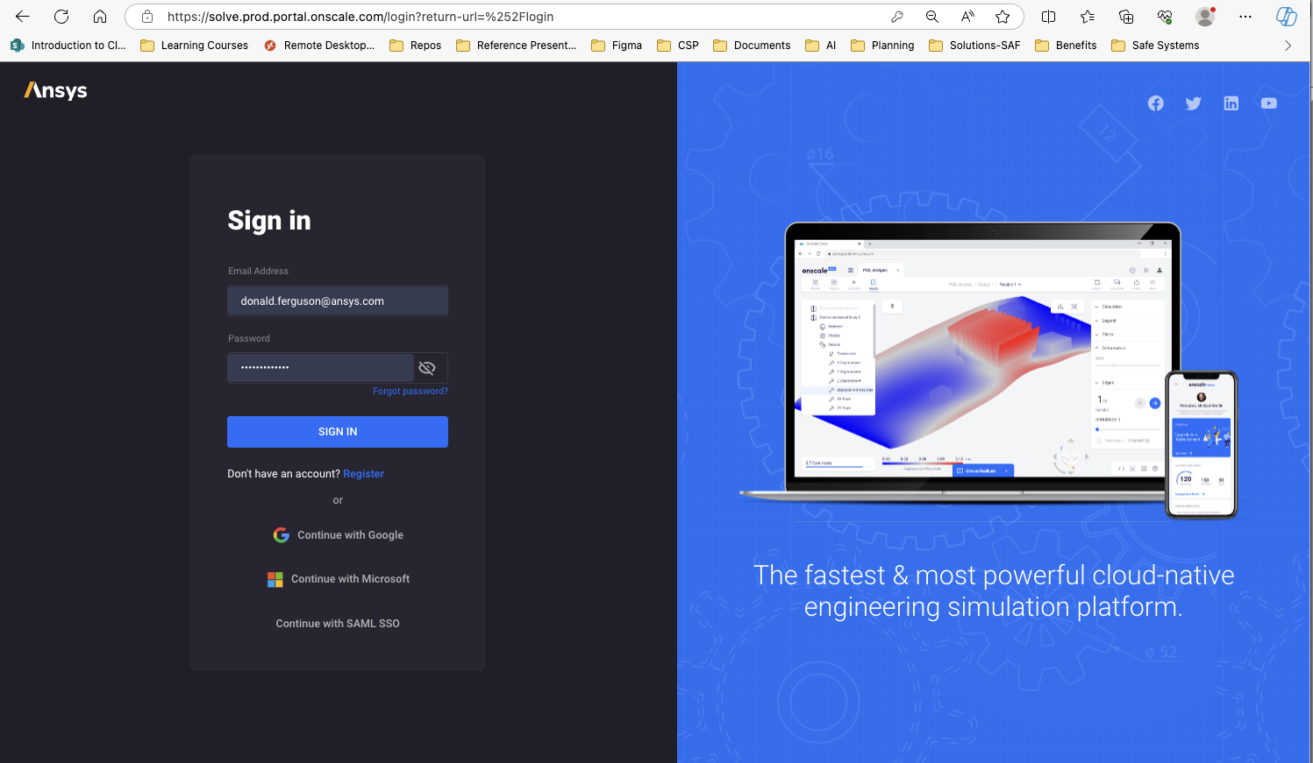
Real Example

Slide 21
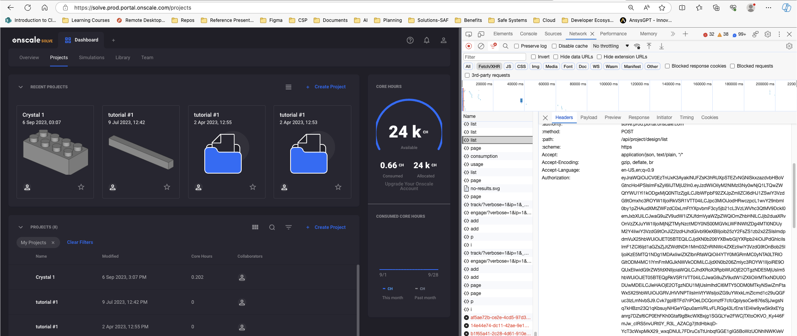
Real Example

Slide 22
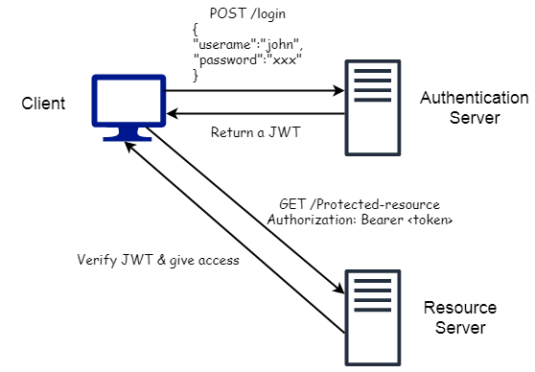
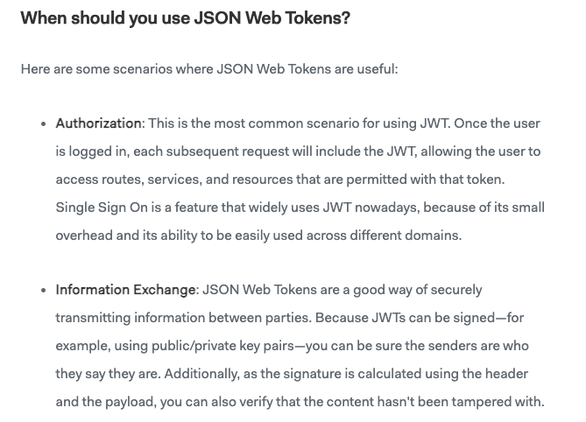
JWT
https://medium.com/swlh/all-you-need-to-know-about-json-web-token-jwt-8a5d6131157f

Slide 23
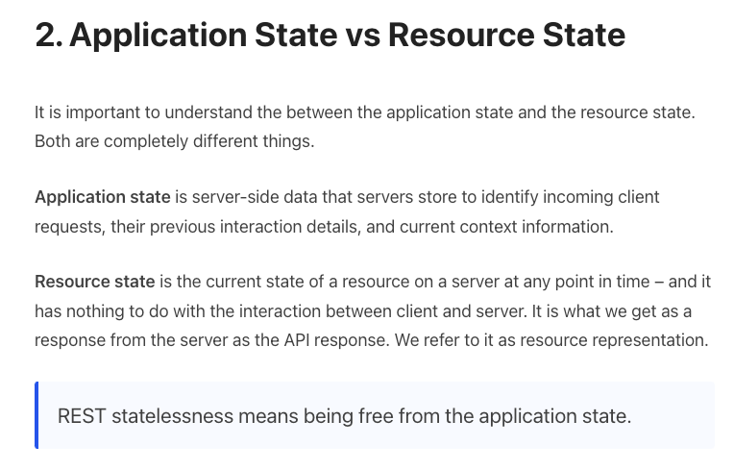
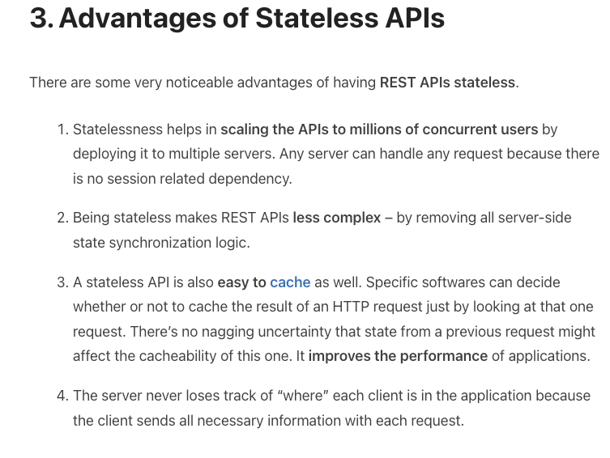
REST is Stateless (https://restfulapi.net/statelessness/)

Slide 24
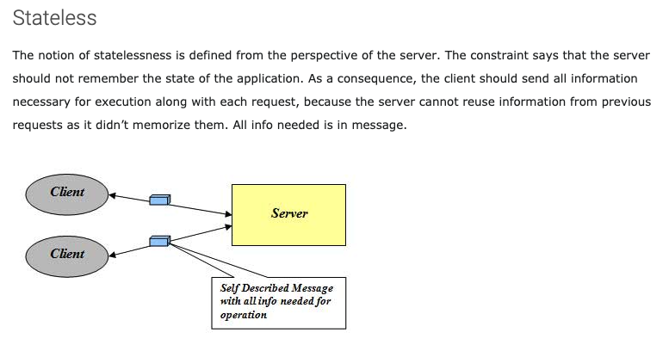
Stateless
http://mrbool.com/rest-architectural-elements-and-constraints/29339
Many platforms provided server-side functions to save session/conversation/application state.
Caching results of previous DB queries.
Current navigation position in a complex, multi-page application.
etc.
REST keeps the information in various headers or cookies. The browser re-provides the information on each request.
This is another use for JWT.

Slide 25
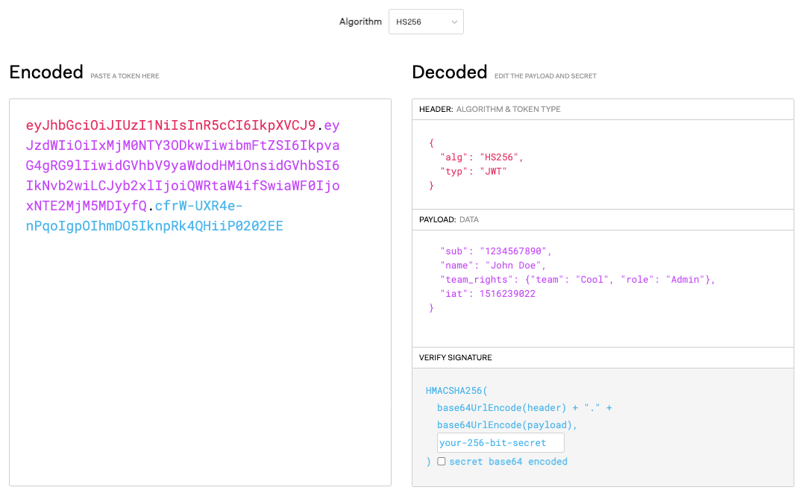
JWT.io

Slide 26
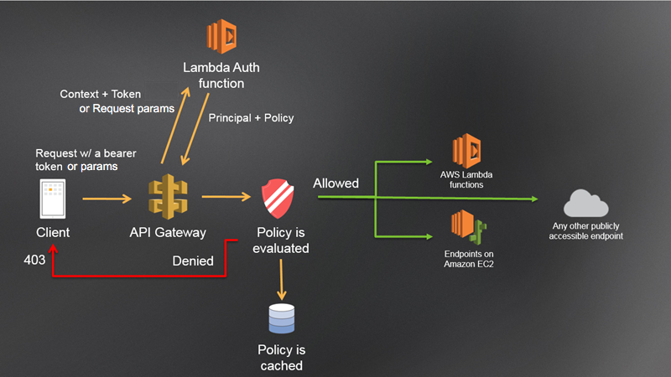
Lambda Authorizer

Slide 27
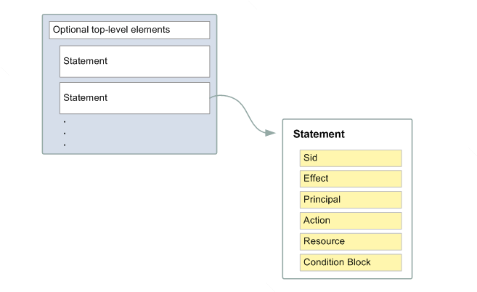
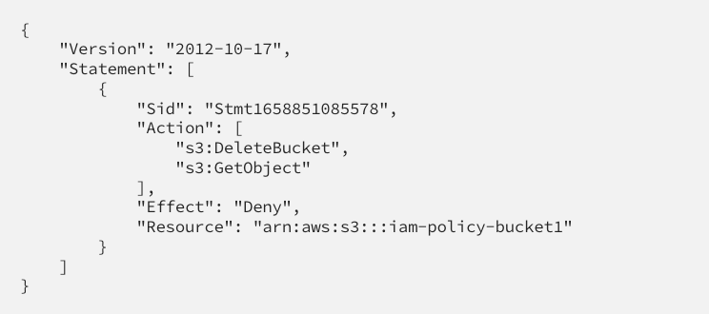
Example and Concepts
Show /Users/donaldferguson/Dropbox/0-F23-Projects/courseworks-lambda/authorizer/example_authorizer.py
The basic concepts in an authorization decision are:
Who is the user/identity?
What is the “ID” of the thing being touched?
What is the operation being performed?
This explains the structure of AWS policy documents (https://docs.aws.amazon.com/IAM/latest/UserGuide/access_policies.html).
Policies get attached to users, roles, groups, … …

Slide 28
Pagination
28 | E6156 – Topics in SW Engineering: Cloud Computing: Lecture 8 - EDA Examples, API-GW, JWT, Pagination © Donald F. Ferguson, 2023

Slide 29
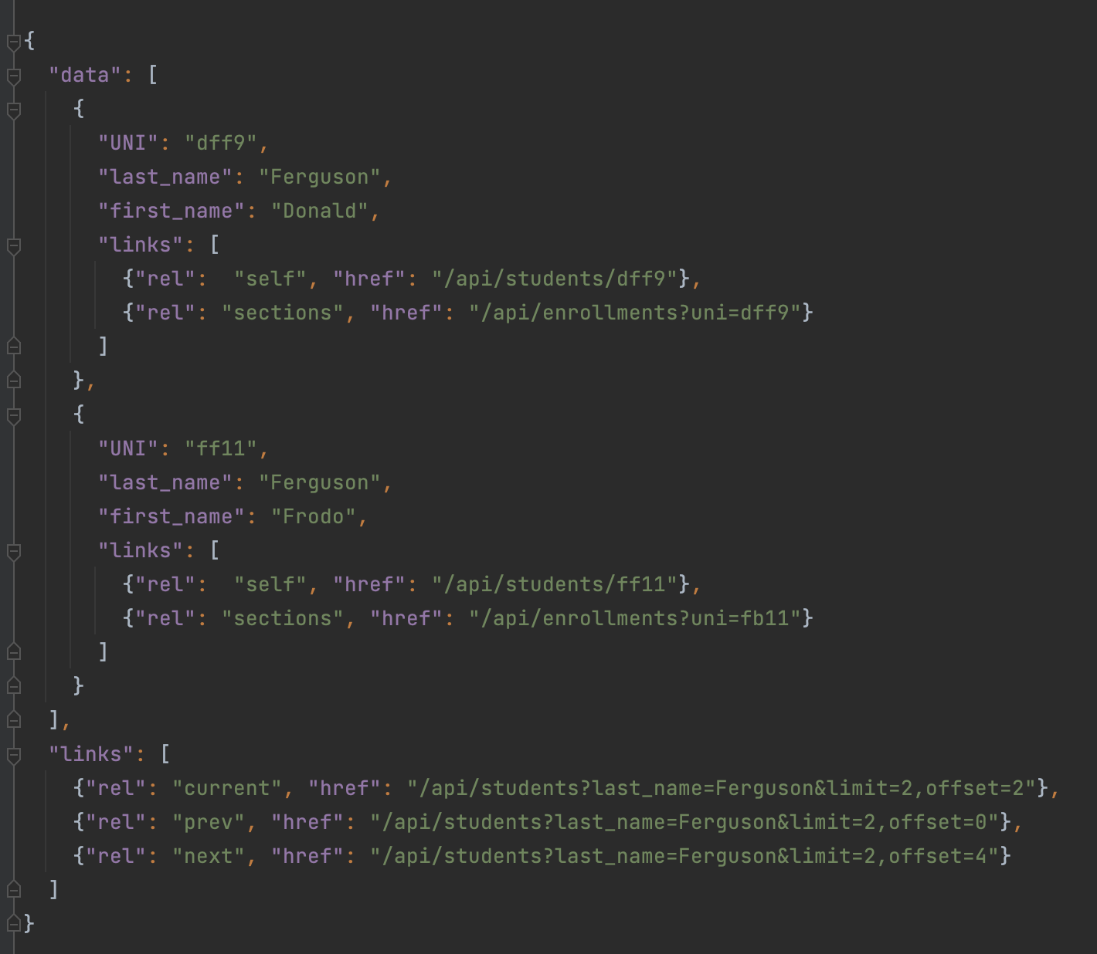
Pagination
Bad things may happen when a GET returns a huge result set.
A page is a window on the large result set.
limit is the no. of entries in the result set.
Client may specific a limit.
Server may have a default and/or maximum limit it allows.
There are many design patterns for implementing pagination.
Simplest is mirroring the SQL model:
limit=xxx&offset=yyy
The links section is the response should contain:
prev
next
current
May contain first and last.

Slide 30
Next Sprint – Writeup will come this weekend
Start using some of the recent concepts.
30 | E6156 – Topics in SW Engineering: Cloud Computing: Lecture 8 - EDA Examples, API-GW, JWT, Pagination © Donald F. Ferguson, 2023

